Slide 1

Florida Red Tide Mitigation and Technology Development Initiative
Kevin Claridge
Mote Marine Laboratory
Associate Vice President
Sponsored Research and Coastal Policy Programs
May 15, 2020

Slide 2
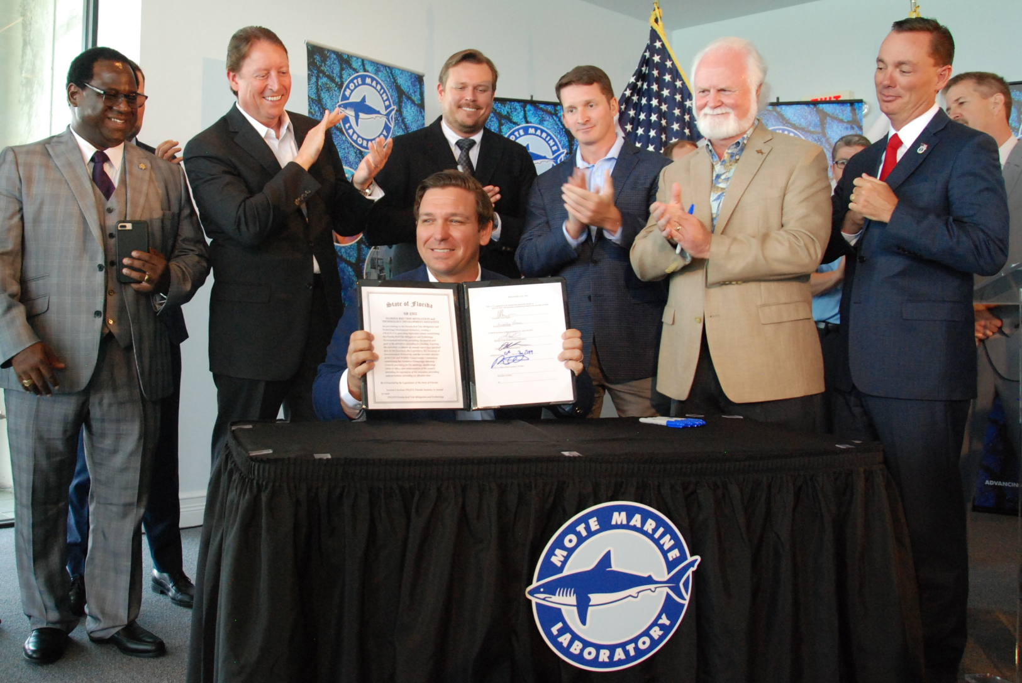
Florida Red Tide Mitigation and Technology Development Initiative

Slide 3
Webinar Agenda
Initiative Overview
Reporting Requirements
Year 1 (July 2019 – June 2020) - Progress
Technical Advisory Council
Initiative Infrastructure
Year 1 Mote Led Projects
Year 1 Partner Led Projects
Year 2 Partner Led RFP and Proposal Guidelines
Q&A

Slide 4
Red Tide Initiative Overview
Signed into law by Florida Governor DeSantis in June 2019
  379.2273 Florida Statutes
  Mote partnership with Florida Fish and Wildlife Conservation Commission, Fish and Wildlife Research Institute
$18 million over 6 years ($3 million per year) contracted by FWC-FWRI to Mote
Legislative intent:
  develop prevention, control, and mitigation technologies and approaches to address the impacts of red tide on coastal environments and communities in Florida
Year 1 (July 2019 - June 2020) and Year 2 (July 2020 - June 2021):
  Infrastructure at Mote – lab space, culture lab, and mesocosms for:
  Mote led projects
  Partner led projects

Slide 5
Initiative Reporting Requirements
Beginning January 15, 2021, and each January 15 thereafter until its expiration, the initiative shall submit a report that contains an overview of its accomplishments to date and priorities for subsequent years to the Governor, the President of the Senate, the Speaker of the House of Representatives, the Secretary of Environmental Protection, and the executive director of the Fish and Wildlife Conservation Commission.
Annual Workplans, Reports, and Invoices to FWRI
Website, Public Records, and Meeting Minutes

Slide 6
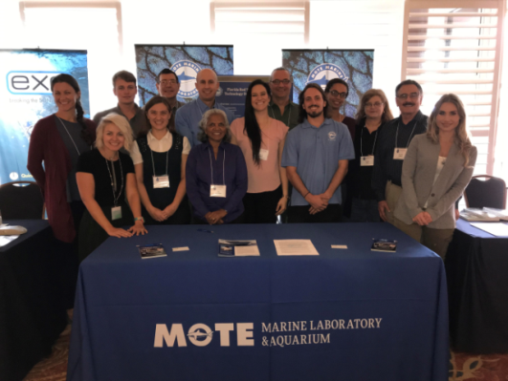
Red Tide Initiative Year 1 Progress
Administrative Structure
  State Contract and Invoicing
Outreach
  press releases, speaking events, conferences, meetings, forums, partner newsletters, webinars, agency websites, and the Mote Red Tide Initiative website
Technical Advisory Council Meetings
  Statutory required meetings on Jan 17th and April 3rd
  Presentations and Minutes on Mote Red Tide Initiative website
Mote Led Projects
  underway
Partner Led Projects
  – RFP, selection, subaward, also underway

Slide 7
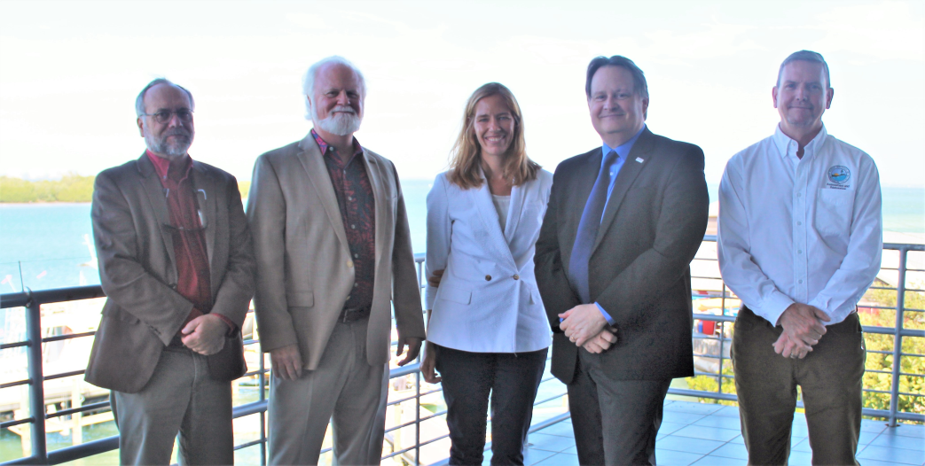
Technical Advisory Council
Dr. Michael P. Crosby – Mote President and CEO
Dr. James Powell – House Speaker Appt
Dr. James Sullivan – Senate President Appt
Dr. Katherine Hubbard – FWC Appt
David Whiting – DEP Appt
Governor Appt Pending

Slide 8
Mote Led Project Overviews
Facilities at Mote’s Sarasota Aquaculture Park
  Mesocosm Facility
  Karenia brevis Culture Facility
Technology Development in Support of Mitigation
  Programmable Hyperspectral Seawater Scanner (PHySS)
  UAV (Unmanned Aerial Vehicle, Drone) based Detection System
  Beach Conditions Reporting System (BCRS)
  Quantitative Polymerase Chain Reaction (qPCR)
Mitigation Projects
  Compounds (Natural, Clay, Chemicals)
  Laboratory and Mesocosm

Slide 9
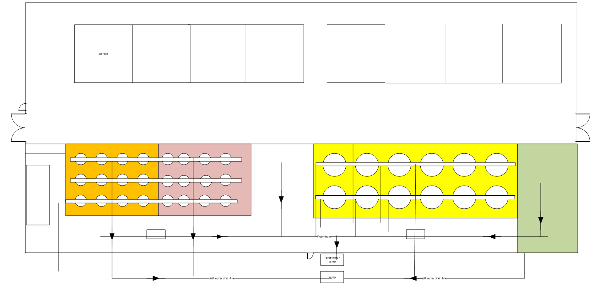

Experimental Mesocosm Facility
Initiative multi-scale, multi-user research infrastructure
Visiting Initiative scientists, graduate students, and educational groups
Ecosystem-based testing of mitigation compounds in a controlled setting to prepare for field implementation
No charge/cost for use and assistance as part of Initiative
Bay
Water
Water Storage
Water Storage
Treatment
5ft Mesocosms
10ft Mesocosms
Chem
Lab
Culture
Lab
Office

Slide 10
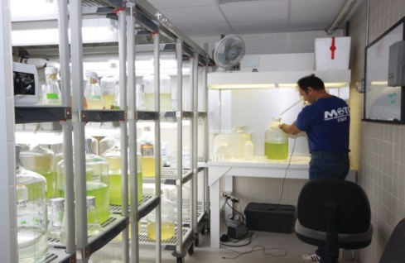
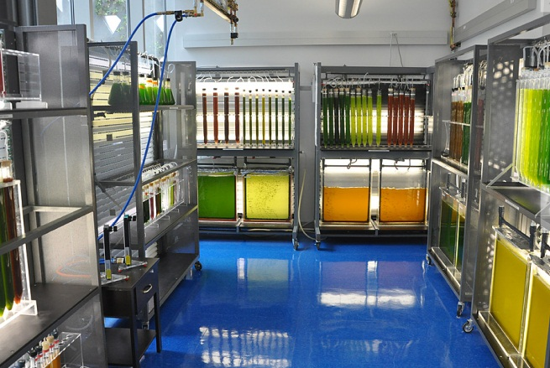
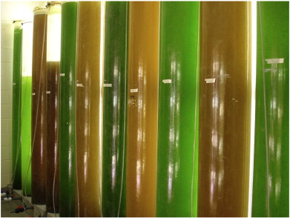
Phytoplankton Culture Facility
Meet the demands of the mitigation research with consistent and reliable production of large volumes of K. brevis
Expand collection of K. brevis species (growing and maintaining several different strains)
Construction largely complete and equipment being installed

Slide 11
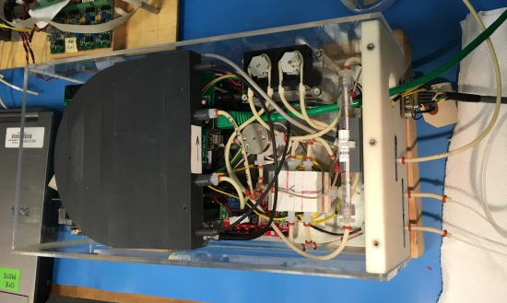
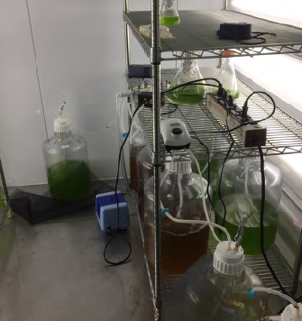
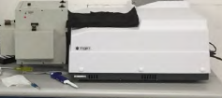
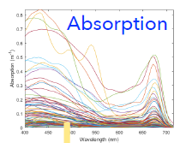
Programmable Hyperspectral Seawater Scanner
PHySS
Develop an instrument to aid in the mitigation of red tide and
provide early detection and warning
Develop a spectral library of different phytoplankton groups with variable morphologies and physiological states, optical signatures will be obtained for a range of cell densities
Improve sensitivity, identify multiple phytoplankton groups
Form observatory providing continuous high frequency data
Data will be made publicly available via web-based platform
Stock Cultures
Optical measurements
Spectral signatures

Slide 12
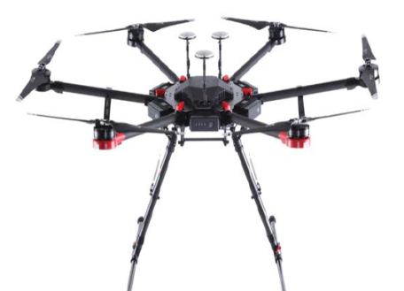
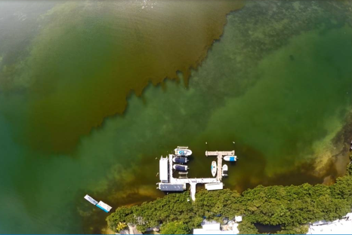
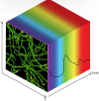
UAV-based Red Tide Detection System
Patchy nature of red tide makes mitigation technology challenging
Airborne hyperspectral sensors could allow the mapping of HABs
Conduct shore-based flights over local waters
Collect hyperspectral data, develop data processing scheme, instrument calibration and deliver proof-of-concept
Decrease costs of detection, improve mitigation application
Imagery of red tide collected from drone
Hyperspectral
data cube
Spatial dimension y
Spatial dimension x
Spectral dimension z (λ)

Slide 13

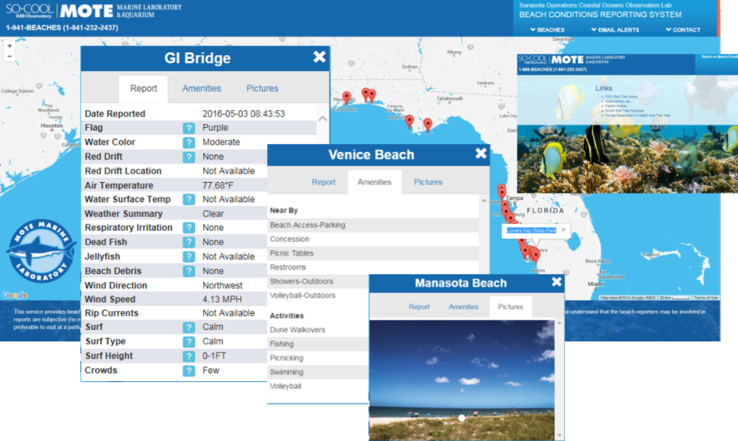
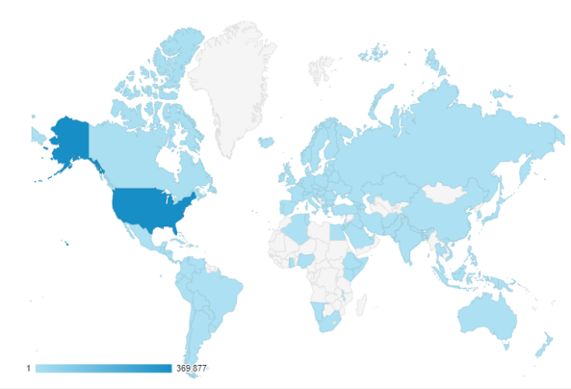
Red Tide Reporting Technology
Alert the Public of Red Tide and its Effects
Red Tide reporting in hands of fisherman
Update/combine the Beach Conditions Reporting System with the Citizen Science is Cool App
Enhance validation components
Information disseminated to BCRS/App, GCOOS, SECOORA and NOAA
Reporting to/by anyone with a Cell Phone, anywhere
Since October 15, 2017
Unique Users: 1.5Million
Page Views: >4.5Million

Slide 14
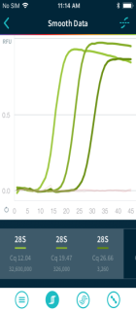
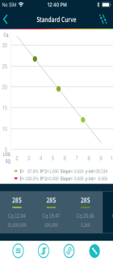
Smart phone qPCR
Web-interfaced detection methodologies that can provide accurate and timely cell monitoring data
Accelerate the development and validation of a hand-held, qPCR based K. brevis detector and develop protocols for integration into Citizen Science program
Biomeme
Three3
Smart
Phone
9 samples per run
3 qPCR assays at once
Stable reagents
Smartphone interface
Cloud-based data storage

Slide 15
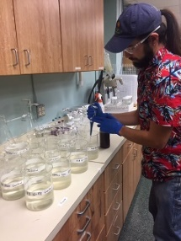
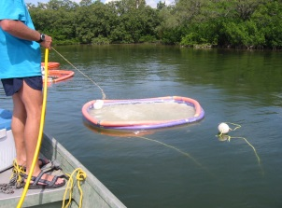
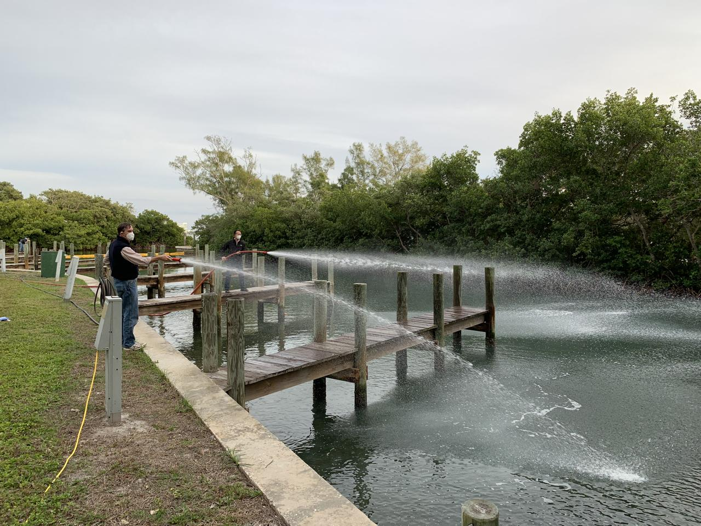
Mitigation Products & Processes
Develop, test, and implement the most effective and ecologically sound products with experts from multiple external research institutions
  Clay, allelopathic plants, and chemical products
Implement a tiered approach to investigate products in a science-based protocol to identify the most effective and ecologically sound products and technologies for mitigation and/or control of adverse impacts of Florida Red Tides
  Tier 1. Lab-scale tests to determine the effective methodology for eliminating K. brevis cells and toxins
  Tier 2. Mesocosm-scale (larger volume, multiple organisms) to assess impacts of non-targeted marine organisms and water quality
  Tier 3. Open Field applications: Test the most appropriate method(s) under natural field conditions (timing depends on outcome of previous tests, permission for field application and red tide events)
Tier-1 Lab studies
Tier-2 Mesocosm- scale
Tier-3
Clay field application in canal

Slide 16
Partner Led Projects
Red Tide Initiative Engagement
Mote will facilitate funding engagement (as stated in Initiative statute):
  Leverage state funds with private and federal funds
  Mote may use a portion of appropriation to fund other marine science and technology development organizations in Florida and around the world to pursue applied research and technology

Slide 17
Partner Led Proposals
Open to any/all interested parties
~$1 Million in funding for partner led projects
  Support not to exceed 1 year, but may request longer in next RFP
  Anticipated $150K-$250K for 4 or 5 awards
Year 1:
  Announced Nov 7, Closed Jan 31
  5 Projects Selected for $1,018,000
  Subawarded in April and May
Year 2:
  Announced May 1, Closes June 30
  Proposal Guidelines on Mote.org
  Submit Proposals to proposal@redtidemtdi.org
    Use of Mote facilities/infrastructure is encouraged
    Partnership with Mote is encouraged
    Partner Led Proposal Review Process:
      Diverse set of red tide PhD level expertise
      Additional Non-Conflicted Mote Scientist Review
        Organized and provide all reviews together for Dr. Crosby’s review
        Presentations to Technical Advisory Council Meeting in Sept/Oct

Slide 18
Year 1 Partner Led Projects
Dr. Kathryn J. Coyne, University of Delaware: Optimizing production of a dinoflagellate–specific algicide for control of Karenia brevis
Dr. Allen Place, University of Maryland: Pushing Karenia Over the Edge with Beer Derived Flavonoids
Dr. Vijay John, Tulane University: A Thin Shroud with Integrated Algaecide to Flocculate and Sink Karenia brevis
Dr. Don Anderson, Woods Hole Oceanographic Institute: Fate and Effects of Karenia brevis Cells, Toxins, and Nutrients Following Clay Application for Bloom Control
Dr. Michael Parsons, Florida Gulf Coast University: Examining the Feasibility of Removing and Composting Fish Carcasses to Mitigate Red Tide

Slide 19
Proposal Guidelines Overview
Checklist
Cover Letter (1 page max)
  Title, PI, Organization, Overview, $ requested, Contact
Project Description (5 pages max)
  Research, Objective, SOW, Timeline, Team and qualifications
Project Budget (2 pages max)
  Salaries, fringe, indirect, equipment, travel, and subcontracts

Slide 20
Questions?
(Type your question in the Chat Box or Contact Kevin)
Kevin Claridge
941-388-4441 ext 275 or kclaridge@mote.org

Slide 21
Webinar Q &A
Q: How can we obtain more information on these projects you mentioned in brief so that our proposals are complimentary yet
not overlapping?
A: Please contact Kevin Claridge for specific Scopes of Works, Proposals, or Contracts – or you can also refer to the presentation
of the 2nd Technical Advisory Council meeting available on the Mote Red Tide Initiative webpage.
Q: Is there a limit on organization overhead rates?
A: No limit, but please provide information on your institution/organization’s usual rate.
Q: Do we need to include Mote costs in our budget?
A: Yes, but please break out any Mote partnership costs separately.
Q: I understand that the mesocosms are at the Sarasota facility. How about the culturing facilities?
A: The Initiative mesocosm facility and culture lab are at the Mote Aquaculture Research Park, 874 WR Mote Way, Sarasota.
Q: How much preliminary data is required in the proposal?
A: You are welcome to provide any historical or preliminary data and reference to support your proposal.
Q: Can we have access to the slides for this presentation?
A: Yes, they will be posted on the Mote Red Tide Initiative website – or you can contact Kevin Claridge and he’ll send them to you.
Q: What are the review criteria:
A: Please reference the Proposal Guidelines on the Mote Red Tide Initiative website. The proposal review process includes
review by a panel of scientists, Mote staff, Mote’s President & CEO, and the Technical Advisory Council in a public meeting.

