Slide 1
Seagrass Restoration Technology Development Initiative 3rd Technology Advisory Council Meeting
Kevin Claridge
Vice President of Sponsored Research & Coastal Policy Programs
February 20, 2025

Slide 2
Meeting Agenda
*Thank you to the Bernard and Norton Wolf Family Foundation for providing the refreshments*
ANERR Intro
Welcome, Logistics, and Meeting Overview
TAC Roll Call
Co-Chair opening comments
Florida Sunshine and Public Records Laws and FAR Notice
Seagrass Initiative Overview
Initiative Partners - DEP, UF, Mote
Seagrass Initiative Progress Overview
Facility Updates
Genetic Management Plan update
DEP Grant Agreement and Reporting Requirements
RFP Year 2 Review and Updates
Year 2 Funding Priorities
Funded Partner’s Project Overview
FWC Presentation
10-Year Seagrass Restoration Plan
Public Comments – 3 minutes each or via card/email
TAC Discussion

Slide 3
Technical Advisory Council
Dr. Michael P. Crosby – Mote, Co-Chair
Dr. Laura Reynolds – UF, Co-Chair
Beau Williams – Governor Appt
Carter Henne – House Speaker Appt
Dr. James Douglass– Senate President Appt
Dr. Bradley Furman – FWC Appt
Scott Eastman – DEP Appt

Slide 4
TAC Opening Comments

Slide 5
Florida’s Sunshine Law
(Review from previous meetings)

Slide 6
Florida Sunshine Law
The Florida Sunshine Law applies to the Seagrass Restoration Technology Development Initiative, Technical Advisory Council.
Florida’s Sunshine Law was created to protect every Floridian’s right to public access of meetings and records concerning government programs, which provides transparency.
This applies to any meeting where official acts are to be taken or public business will be discussed.

Slide 7
Reasonable Notice of Meetings
The public must be given reasonable notice of meetings that are to occur.
DEP generally recommends notice for public advisory group meetings to be published in the Florida Administrative Register no less than 7 days before the meeting and ensure that it is posted on the Initiative website.
Posted on February 6, 2025

Slide 8
Minutes of Meetings
Minutes of meetings must be taken and documented, but do not have to be verbatim.
This meeting’s minutes will be posted on the Mote Seagrass Ecosystem Research & Restoration website with previous meetings' minutes, agenda, and presentation.
Advisory Boards are not required to have audio recordings of their meetings; but if a meeting is recorded by a member or staff then it is a public record.

Slide 9
Restrictions on Outside Discussions
Any discussion between two or more members of the Technical Advisory Council discussing a topic which may foreseeably come before their board must occur in the sunshine.
You are not restricted from socializing with other members of the Council, but you may not discuss anything that may foreseeably come before the board.
Discussion of official matters outside of a public meeting is a violation of the Sunshine Law.

Slide 10
Public Records
This Technical Advisory Council is subject to Florida’s Public Records Law (even if you yourself are not a government employee), because records relating to the Seagrass Restoration Technology Development Initiative are made or received in connection with the transaction of the official business of the State.
Public Records are ALL documents, papers, letters, maps, books, tapes, photographs, films, sound recordings, data processing software, etc. regardless of the physical form…or means of transmission made or received in connection with official action of an agency. Sec. 119.011(12), F.S.
Public records must be open and available for the public to inspect and copy.
This includes emails, text messages, and social media.

Slide 11
Seagrass Restoration Technology Development Initiative Overview

Slide 12
Seagrass Initiative Overview
Signed into law by Florida Governor DeSantis in July 2023
403.93344 Florida Statutes
Partnership with DEP and UF
$10 million over 5 years contracted by DEP to Mote
Grant Agreement Executed February 2024
Legislative intent:
establish a collaborative and coordinated effort among public and private research entities to develop restoration technologies and approaches to address the loss of seagrass and the cascading ecological and economic impacts of that loss to communities in this state
department shall award funds specifically appropriated by the Legislature for the initiative to Mote Marine Laboratory, which shall function as the lead administrative component to achieve the goals of the initiative
initiative shall leverage state-appropriated funds with additional funds from private and federal sources
Mote Marine Laboratory and the University of Florida shall create a 10-year Florida Seagrass Restoration Plan to implement tools and technologies developed under the initiative

Slide 13
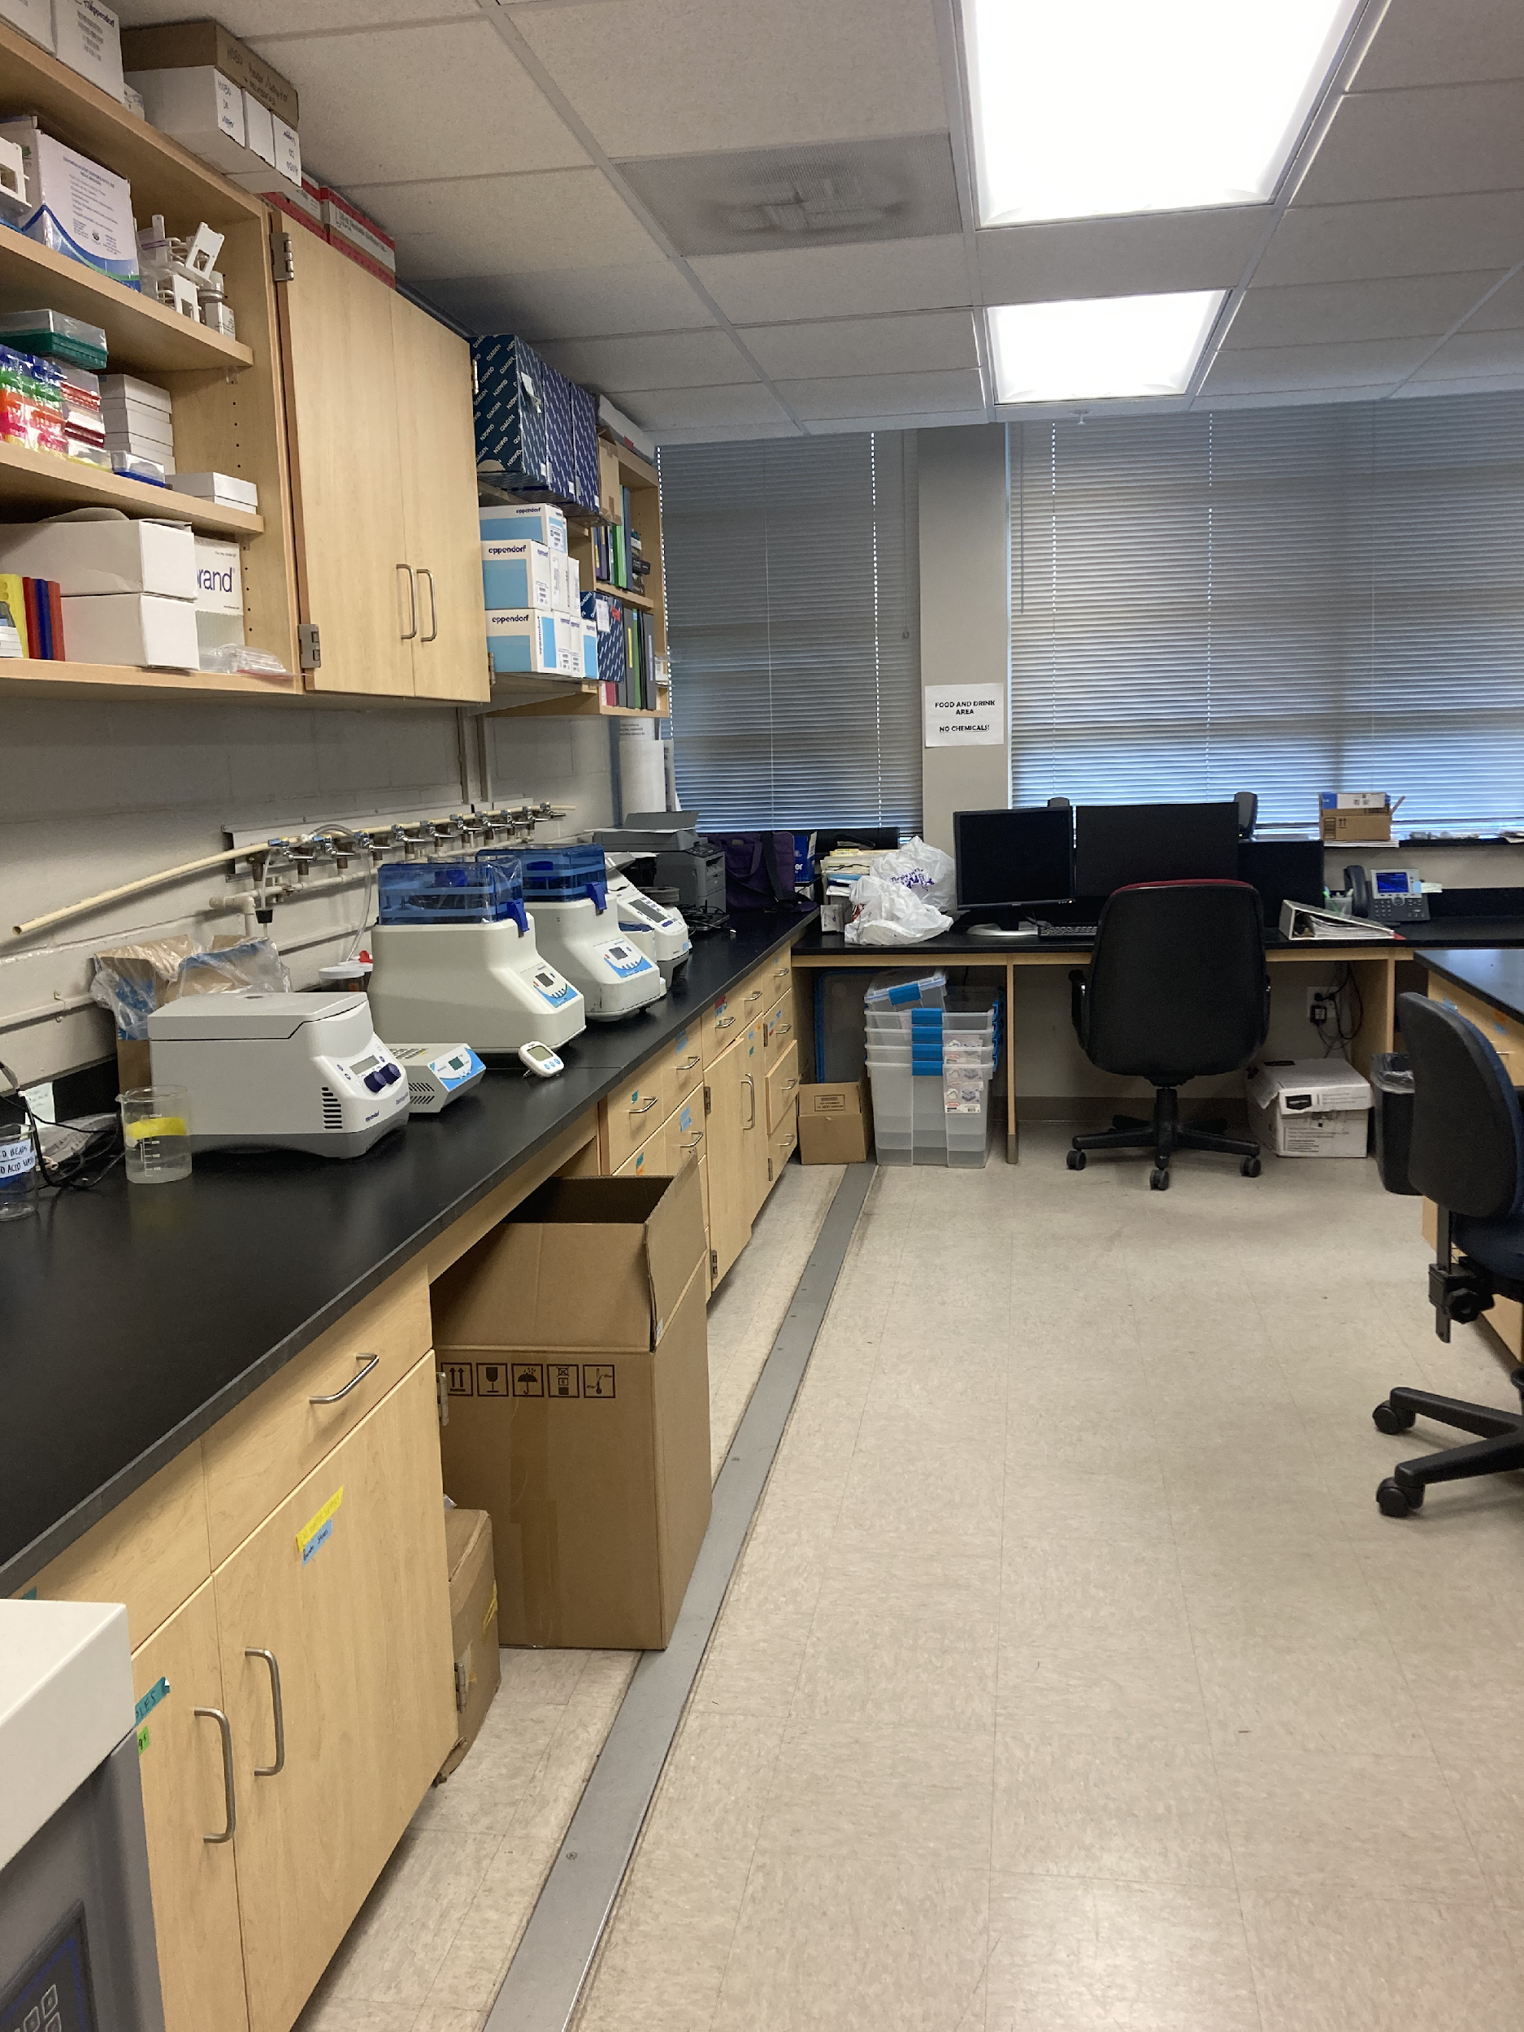
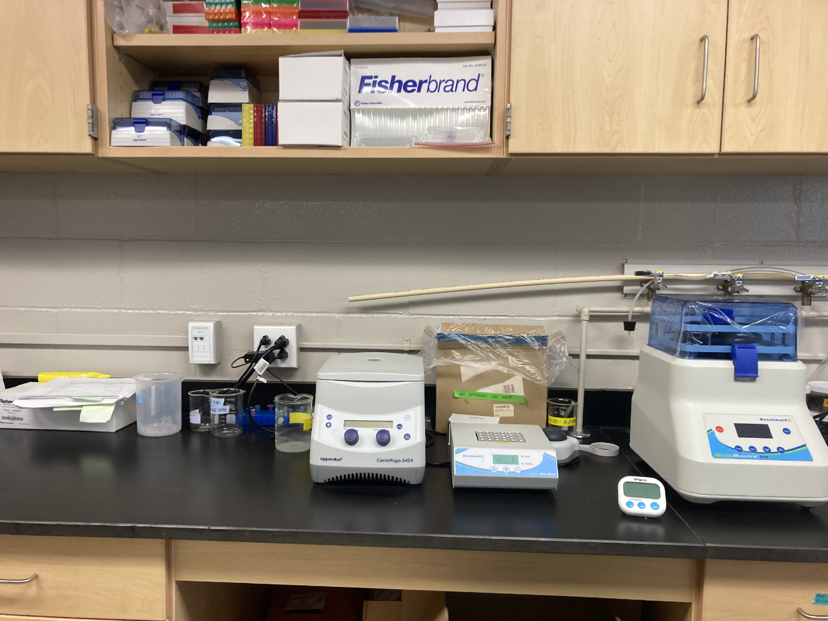
Initiative Partner: University of Florida
Department of Soil, Water, and Ecosystem Sciences
Coastal and Marine Ecology Laboratory
Dr. Laura Reynolds, Assistant Professor Coastal Ecology
Genetics Lab for Seagrass Initiative

Slide 14
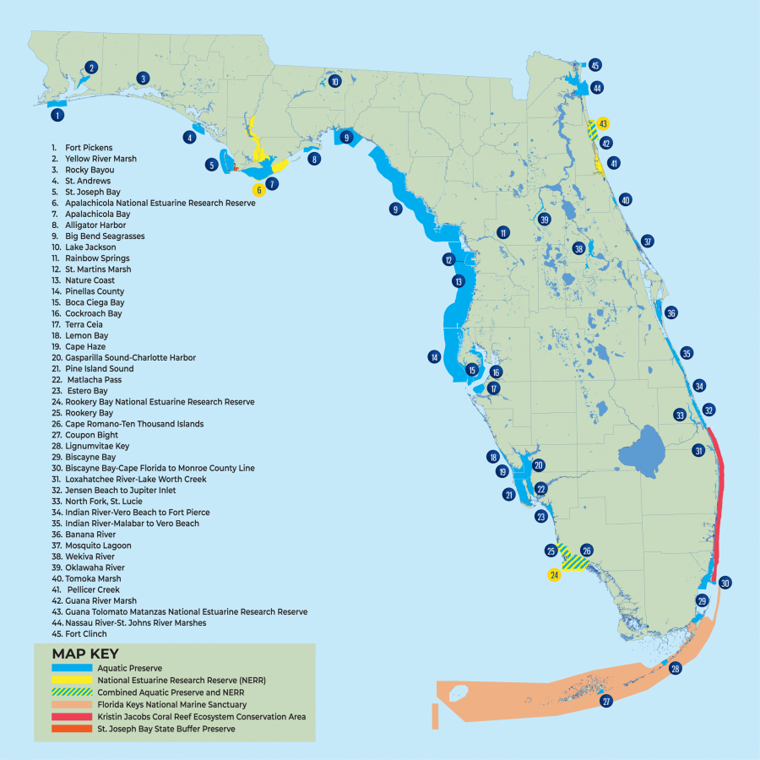
Initiative Partner: DEP Aquatic Preserve Program
Aquatic Preserve Act
258.35-258.46 F.S
“Ensure continuation of natural conditions of aesthetic, biological and scientific value”
43 Statewide Preserves
2.6 Million Acres
Place-Based Experts on:
Natural resources, ecological trends, stressors, research conducted/underway, recreational uses, partners, stakeholders, etc.

Slide 15
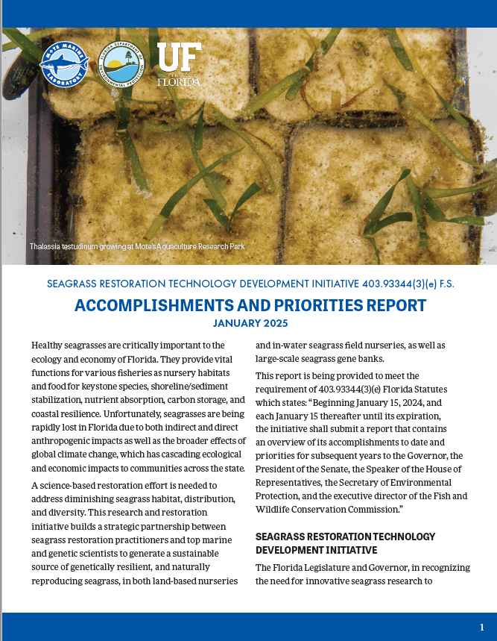
Seagrass Initiative Progress
Mote Administrative Structure
1st and 2nd Accomplishments and Priorities Report
Leveraged Funding
NOAA
Philanthropic
New Genetics Lab Funding from Publix
Released competitive 1st RFP
Reviewed and funded 8 projects
Executed subcontracts
Projects underway
Receiving Interim Reports
Initiative Technical and Financial Reports submitted
Released 2nd competitive RFP
Proposal reviewal underway
Continued work with consulting firm, Moffatt & Nichol, on the 10 Year Seagrass Restoration Plan
116 management documents reviewed
Greenhouse structure completed
Seagrass growing
Outfitting “house” for visiting researcher lodging
Thalassia seedling collection from the Keys
Outfitting existing lab space and planning Genetics Lab expansion

Slide 16
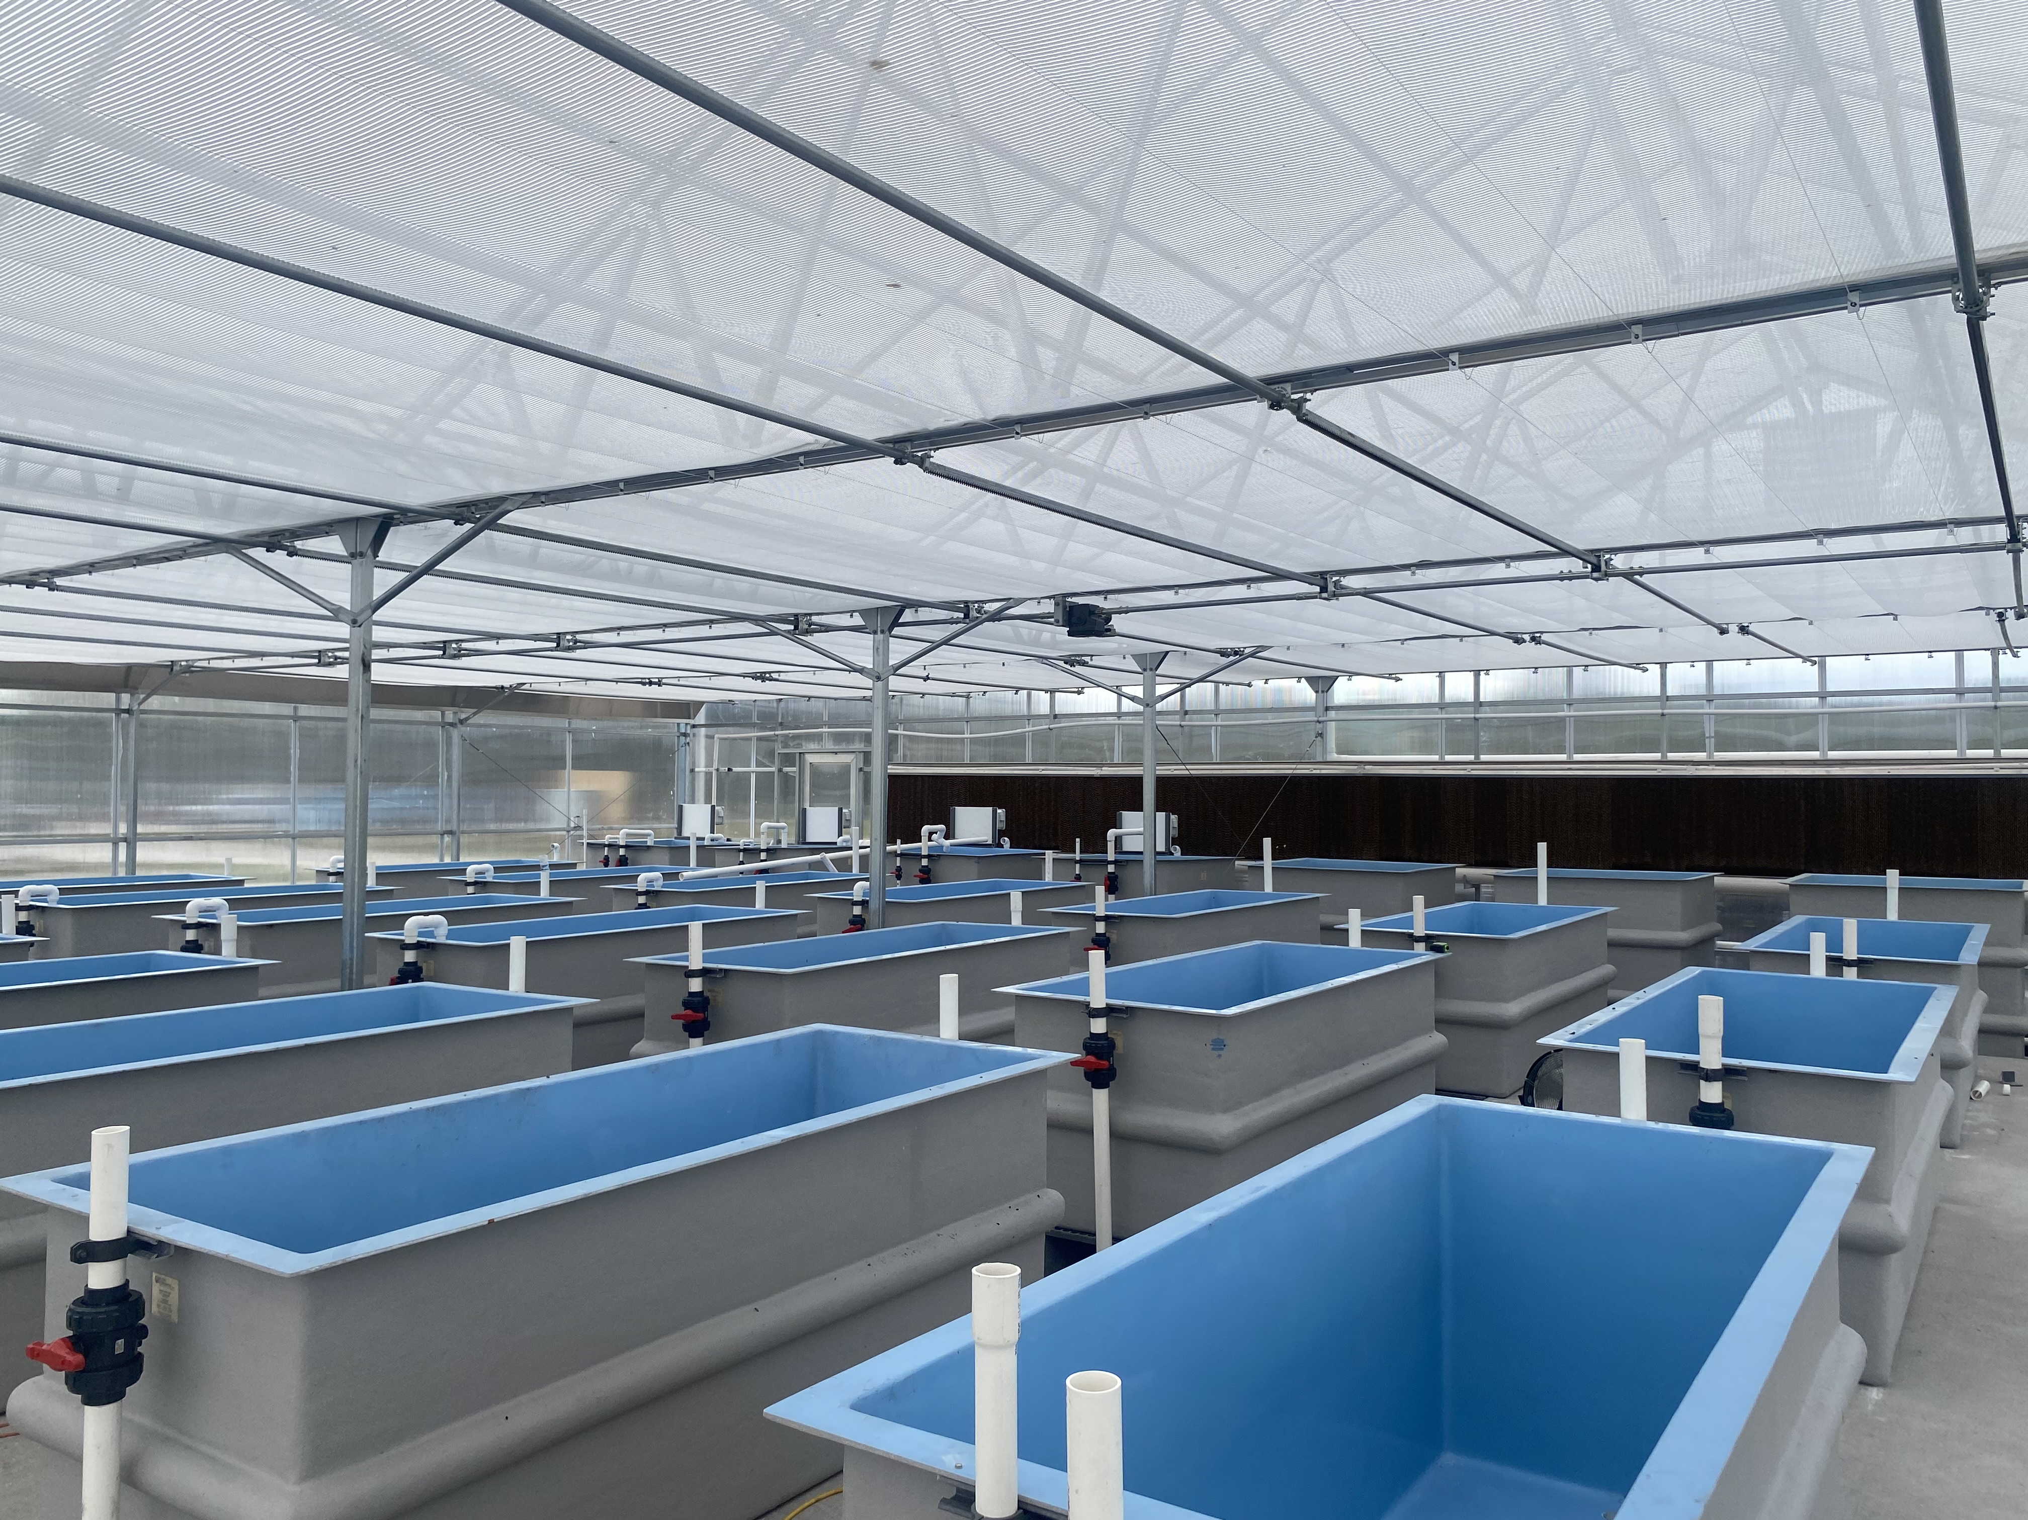
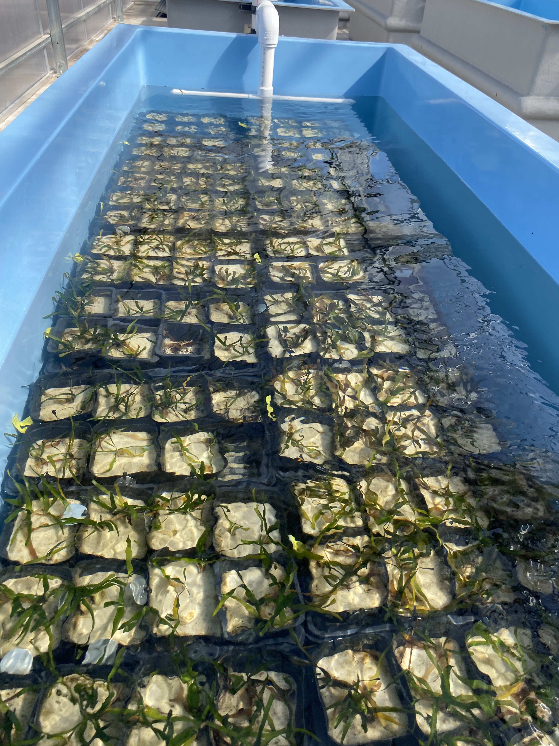
Initiative Research Infrastructure
Provide multi-user seagrass research infrastructure for Initiative scientists
Free of charge for Initiative projects
Technician assistance
Seagrass education and outreach
Test variety of field stressors (e.g. temperature, clarity, light, salinity, nutrients, pH) in a controlled setting
Assist determination of resilient seagrass genotypes
Hold diversity of genotypes and ecotypes for research
Additional raceway locations coming on-line soon in Florida Keys

Slide 17
Greenhouse Schematic

Slide 18
Coming soon: Publix Seagrass Genetics Research Laboratory Hub
Funded by Publix Supermarkets, Inc.
Building design underway
Planned completion late summer 2025
Located at Mote Aquaculture Park in Sarasota

Slide 19
Genetic Management Plan Update
Waiting to receive samples from funded partners for the genetic library
SOP was sent to the year 1 funded projects
Approximately 4 cm of tissue sample should be collected per individual
Place samples into a teabag, place teabags into ziplock bags with blue-indicator silica gel
Mail samples at ambient temperature overnight to Mote
Please email me the associated metadata – website coming soon

Slide 20
Genetic Management Plan Update
Looking into using BreedBase at the Boyce Thompson Institute located at Cornell University to track genotypes and associated metadata
Currently used for many crop applications including Cassava, sweet potato, banana, and others
Does anyone have any opinions, thoughts or suggestions?

Slide 21
Genetic Management Plan Update
Testing 2bRAD genotyping on samples previously genotyped with microsatellites
Refining laboratory pipeline
Designing several experiments to complement testing genetic resilience to stressors in collaboration and tandem with funded projects and Initiative partners

Slide 22
Genetic Management Plan Update
Project 1:
Assessment of genetic diversity across the state of Florida
In collaboration with funded partners and regional experts, we are collecting seagrass of multiple species and will genotype them using 2bRAD sequencing technologies
Will correlate the genetic diversity with the local environmental factors incorporating the SEACAR database

Slide 23
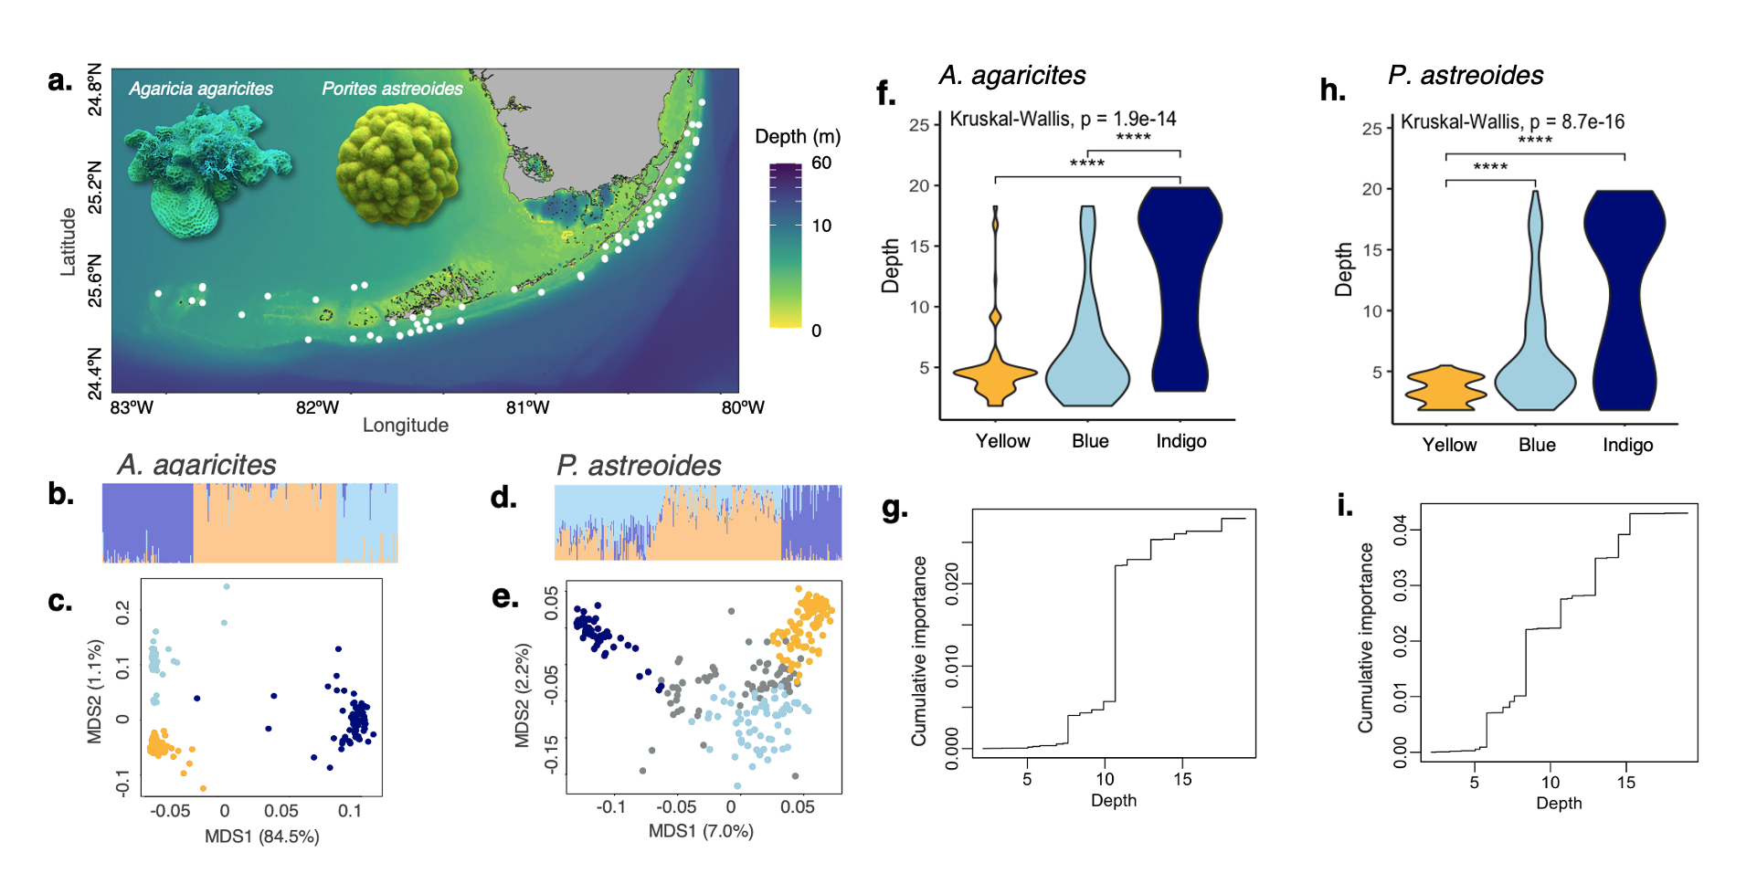
Genetic Management Plan Update
Black et al. 2022

Slide 24
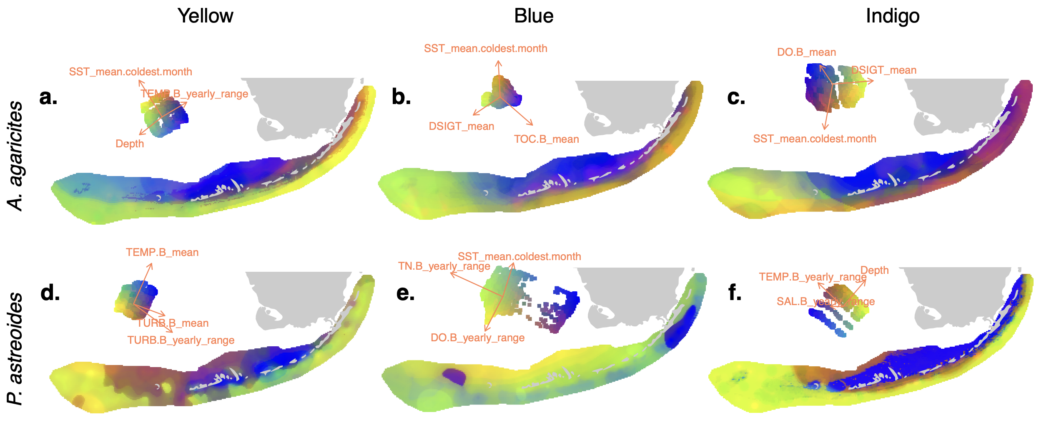
Genetic Management Plan Update
Black et al. 2022

Slide 25
Genetic Management Plan Update
Project 2:
Identification of resilient genotypes utilizing common garden approaches
The stressors tested and the exact values (e.g., degrees, PAR, ppt) will be driven by the local conditions from which the seagrass originated

Slide 26
Genetic Management Plan Update
Identifying genotypes that are resilient
Genotype 1
Genotype 2
Genotype 3

Slide 27
Genetic Management Plan Update
Focused Stressors
TEMPERATURE
WATER CLARITY

Slide 28
Genetic Management Plan Update
Potential treatments for two stressors:
Temperature | Water clarity
Current | Current
Current | Reduced
High | Current
High | Reduced
Notes:
Assuming single direction -

Slide 29
Genetic Management Plan Update
Results from these studies, and those from our funded collaborators, will ensure that we are able to select genotypes for restoration that preserve both overall genetic diversity across the state and focus on genotypes that are resilient to current and future stressors

Slide 30
Initiative Reporting Requirements
Beginning January 15, 2024, and each January 15 thereafter until its expiration, the initiative shall submit a report that contains an overview of its accomplishments to date and priorities for subsequent years to the Governor, the President of the Senate, the Speaker of the House of Representatives, the Secretary of Environmental Protection, and the executive director of the Fish and Wildlife Conservation Commission.
DEP Contract Technical and Financial Reports
Public Website
TAC Meetings – FAR, Presentations, Public Comments and Minutes
Public Records

Slide 31
Initiative Research Engagement
403.93344(3)(C)(1): Mote Marine Laboratory may, with the concurrence of the department, use a portion of the awarded funds to facilitate additional engagement with other pertinent marine science and technology development organizations in this state and around the world to pursue applied research and technology for the successful restoration of seagrass ecosystems.

Slide 32
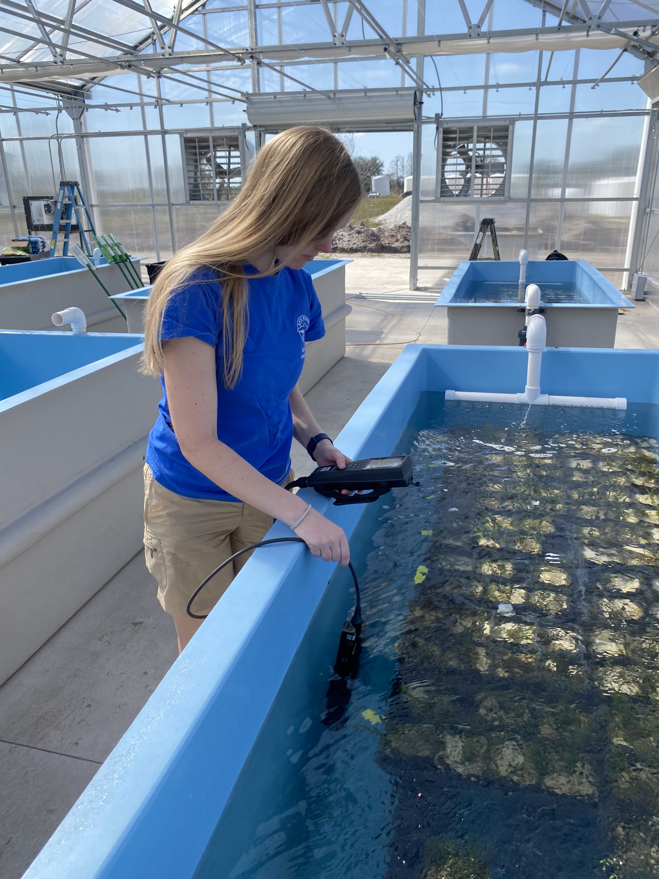
Year 2 Request For Partner Research Proposals
Opened December 13th , 2024 through January 31st, 2025
Anticipated RFP grant funding in Year 2 is $1M+
Likely $50-$250K for each grant, 4-8 organizations
Support not to exceed 1 year
may request longer in subsequent RFP
No Match Required
Use of Mote facilities/infrastructure is free of charge
Collaboration with Mote, UF, and DEP encouraged but not required
Year 2 proposals currently under review
Proposal Reviewer Scientists:
DEP Aquatic Preserves, UF, and Mote scientists
Each scientist will review proposals using provided rubric
Projects will generally receive 50% of the awarded funds upon contract execution
25% upon approval of the Interim Report
25% upon approval of the Final Report

Slide 33
Year 2 Funding Priorities
Year 2 of the Initiative will focus on:
identifying the genetic diversity of seagrass populations and associated environmental stressors across Florida;
developing a genetic library of Florida seagrass;
testing the resilience of different statewide seagrass populations to multiple environmental stressors in controlled lab and nursery settings;
testing for specific genes that confer resilience to multiple environmental stressors within statewide seagrass populations
examining existing seagrass restoration technologies and planting techniques, and/or conduct planning efforts and pursue regulatory approval for testing novel seagrass restoration technologies;
organizing and encouraging collaboration among the scientists and restoration practitioners working on Florida seagrass genetics to achieve the goals of the Initiative (this will be partially accomplished through this RFP and Initiative Technology Advisory Council meetings).
Emphasized reference to DEP’s Statewide Ecosystem Assessment of Coastal and Aquatic Resources (SECAR) database to review habitat data and determine potential environmental stressors in your geographic research area.

Slide 34
Year 1 Funded Partner Presentations

Slide 35
FWC Presentation
Becca Hatchel from FWC’s Fish & Wildlife Research Institute Ecosystem Assessment & Restoration Section
Seagrass Integrated Mapping and Monitoring (SIMM) Report

Slide 36
10-Year Florida Seagrass Restoration Plan
403.93344(3)(d) F.S.:
“In collaboration with the program, Mote Marine Laboratory and the University of Florida shall create a 10-year Florida Seagrass Restoration Plan to implement tools and technologies developed under the initiative.”
DEP Grant Work Plan:
This work may, in part, be subcontracted by Mote to an external entity selected by Mote.
The Department, Mote, and University of Florida will oversee the development of the plan over the five years of the Initiative, may publish/release drafts and updates with the legislatively required Annual Report, may conduct workshops with seagrass research/restoration partners to facilitate practitioner/public input, and shall submit a Final Plan to the Department for implementation by June 30, 2028.
Moffatt & Nichol, Coastal Resilience Lead, Becky Prado presentation
TAC Discussion at end of presentation

Slide 37
Public Comments: Please limit to 3 minutes or less
or via Comment Card or Email

Slide 38
TAC Comments and Recommendations
Potential Discussion Topics:
Codifying 10-Year Restoration Plan
Leveraging Opportunities
Agency/Company/Institution Seagrass Update
Next TAC Meeting Location NERR increased involvement? HAB/Seagrass Research

